Slide 1
Model-Informed Drug Development Case Studies
ECP 8506 Clinical Trial Simulation
Dec 13, 2024
Ya-Feng (Jay) Wen, PharmD, PhD
wenxx164@umn.edu | jay.wen3@gilead.com
Clinical Pharmacologist, Gilead Sciences
Adjunct of Assistant Professor, ECP, UMN

Slide 2
Learning Objectives
Apply the simulation considerations learned so far and drive simulation plans to address drug development questions
Present the simulation plans with a clear and succinct manner

Slide 3
Instruction
Students work in a team to propose and present the simulation plan
The simulation plan should include the following:
A credibility assessment (slide 4), including the following component: Question of interest, Context of use, Model risk (Model influence and Decision consequence), Validation plan
Simulation scenarios, including but not limited to model(s) to use, number of subjects in a simulation, number of simulations, simulation outcomes

Slide 4
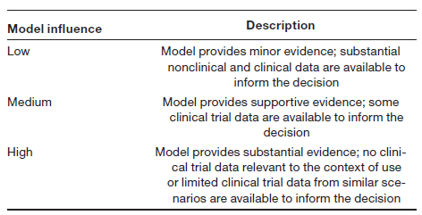
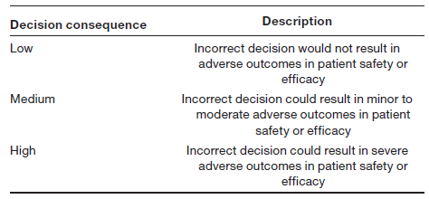
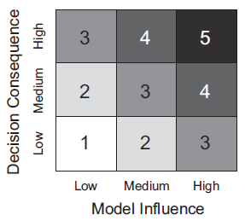
Credibility assessment framework in MIDD
No
Question of interest
Context of model use
Assess model risk
Establish Risk-informed credibility
Assess
Credibility
Yes
Documentation
& Evidence
Establish Credibility Goals → Establish Plan→ Execute Plan
Verification: code, calculation
Validation: model assumptions/inputs; comprehensive review in vitro/in vivo data and literature; model validation with clinical data; model applications
Model influence: labeling claims by considering the totality of evidence
Decision consequence: impact of a wrong decision on patient care
Model Risk
Kuemmel C, et al. Consideration of a Credibility Assessment Framework in Model-Informed Drug Development: Potential Application to Physiologically-Based Pharmacokinetic Modeling and Simulation. CPT Pharmacometrics Syst Pharmacol. 2020;9(1):21-28.

Slide 5
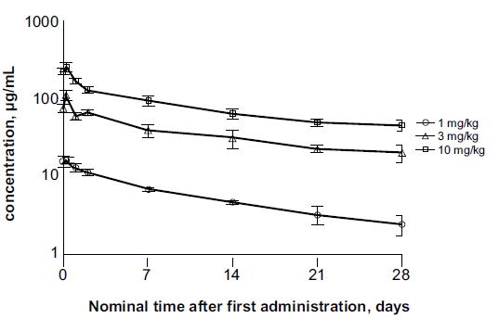
Case Study 1
Drug A is a monoclonal antibody in the early clinical development for solid tumors.
A Phase 1 study was a 3+3 dose-escalation cohort followed by an expansion cohort.
Three-patient cohorts sequentially were administered Drug A 1, 3, or 10 mg/kg intravenously over 30 minutes on day 1, day 28, and every 2 weeks thereafter.
Seven additional patients were enrolled in an expansion cohort and treated with 10 mg/kg every 2 weeks.
The concentration-time profile from the phase 1 study is shown below
Half-life ranges from 14-22 days
Dose seemed to be disproportionally lower at 1 mg/kg
than 3 or 10 mg/kg by the plot and AUC assessment
Preliminary PopPK models were constructed (next slide)

Slide 6
Case Study 1—Cont’d
Parameter (units) | Linear |  |  | Nonlinear
 | Estimate | %RSE | BSVª (RSE%) | Estimate | %RSE | BSVª (RSE%)
OFV | 364.352 | — | — | 370.950 |  | —
CL (L/d) | 0.180 | 14.2 | 28.8 (62.5) | 0.180 | 13.6 | 24.6 (68.1)
V_{c} (L) | 2.537 | 7.3 | — | 2.524 | 8.1 | —
V_{p} (L) | 2.154 | 17.9 | — | 2.152 | 18.3 | —
Q (L/d) | 0.595 | 31.5 | — | 0.600 | 31.9 | —
covF1 | –0.369 | –18.7 | 14.2 (97.9) | NA |  | 22.4 (63.3)
F_{min} | NA |  | — | 0.200 |  | —
FD₅₀ | NA |  | — | 0.582 | 52.5 | —
αCL | 0.448 | 93.6 | — | 0.455 | 81.4 | —
αV | 1.000 | 18.4 | — | 0.987 | 21.7 | —
RUV (prop) | 0.200 | 8.4 | — | 0.202 | 8.7 | —
RUV (add) | 0.010 |  | — | 0.010 |  | —
Abbreviations: %RSE, relative standard error; αCL, exponent of bodyweight–clearance relationship; αV, exponent of bodyweight–volume relationship; BSV, between-subject variability; CL clearance; covF1; , covariate relationship F for 1 mg/kg F, bioavailability; FD50, dose at half-maximal impact on bioavailability; Fmin, minimal bioavailability; NA, not applicable; Q, intercompartmental clearance; proportional; RUV (add), residual error PK, additive; RV (prop), residual variability PK, proportional; Vc, central volume of distribution; Vp, peripheral volume
ªBSV was calculated as sqrt(exp(variance)-1)

Slide 7
Case Study 1—Cont’d
The team wants to enroll additional patients to detect or reject whether Drug A has nonlinearity in PK, while minimizing the probability of drawing the wrong conclusions
Two study designs were considered by the team:
The team wants you to propose a simulations strategy to evaluate the likelihood of success between the 2 study designs
Note: ideally, re-estimation of PK parameters should be performed based on the simulated data and evaluate the bias and precision of parameter estimates. Since it is out of scope of this course, please only focus on the simulation strategy.
Design 1 | Dose, mg/kg
Cohort | 0.02 | 0.1 | 0.3 | 1 | 2 | 10
1 (n=3) |  | X | X |  | X
2 (n=3) |  |  | X | X | X
3 (n=3) | X |  |  |  | X | X
Total (n=9) | 3 | 3 | 6 | 6 | 9 | 6
Design 2 | Dose, mg/kg
Cohort | 0.005 | 0.02 | 0.06 | 0.3 | 1 | 2 | 10
1 (n=3) | X |  |  | X |  | X
2 (n=3) |  | X |  | X |  | X
3 (n=6) |  |  | X |  | X |  | X
Total (n=12) | 3 | 3 | 6 | 6 | 6 | 6 | 6

Slide 8
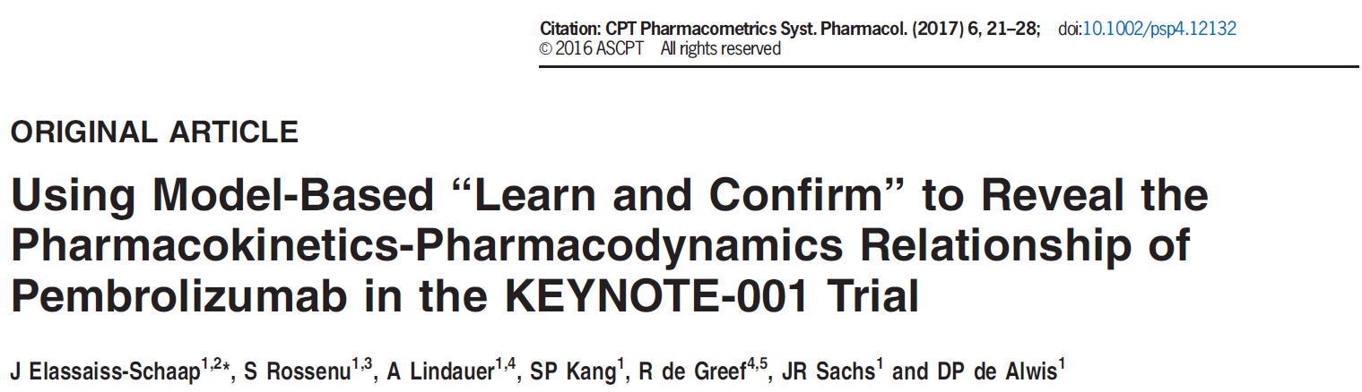
Case Study 1—Cont’d
Elassaiss-Schaap C, et al. Using Model-Based “Learn and Confirm” to Reveal the Pharmacokinetics-Pharmacodynamics Relationship of Pembrolizumab in the KEYNOTE-001 Trial. CPT Pharmacometrics Syst Pharmacol. 2017; 6, 21-28.

Slide 9
Case Study 1—Cont’d
Category | Context of use
Question of interest | Whether Drug A exhibits nonlinearity in pharmacokinetics?
Context of use | Use stochastic simulation and estimation (SSE) to evaluate the PK of Drug A Simulate 2 scenarios (Design 1 and Design 2) with 2 different models: linear and non-linear Evaluate the false discovery rate (the probability of detecting the nonlinear model when simulations were performed with the linear model) and root mean-squared error (RMSE%) for each parameter was compared across the different designs
Model risk | Low
Model influence | Low The model was used to inform the study design of an additional study The simulation is using the PK models based on the limited dose range and limited sample size Additional PK data from either Design 1 and 2 can help to inform the PK property of Drug A
Decision consequence | Low The efficacious dose range of Drug A likely exhibits linearity
Validation plan | Conduct a follow-up clinical study based on the result of SEE to further evaluate the PK of drug A
Elassaiss-Schaap C, et al. Using Model-Based “Learn and Confirm” to Reveal the Pharmacokinetics-Pharmacodynamics Relationship of Pembrolizumab in the KEYNOTE-001 Trial. CPT Pharmacometrics Syst Pharmacol. 2017; 6, 21-28.

Slide 10
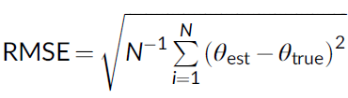
Case Study 1—Cont’d
Each scenario was run in 2 versions, one using a linear pharmacokinetic (PK) model for simulation and another with a nonlinear model.
Each scenario was evaluated with SSE 100 times each.
The objective was to determine the ability to detect or reject nonlinearity in pharmacokinetics, while minimizing the probability of drawing the wrong conclusions.
The probability (fraction of simulations) of detection of the nonlinear model when simulations were performed with the linear model (the false discovery rate) was calculated and the root mean-squared error (RMSE%) for each parameter was compared across the different designs.
For each scenario, the median and largest (“extreme”) RMSE of each parameter were calculated as key criteria for comparison of the performance of the different designs.

Slide 11
Case Study 1—Cont’d
Scenario | Dosing Schedule | Simulation Model | Estimation Model | Mean dOFV^{c} | Power % dOFV <5.99ª | False Positive Rate (dOFV >5.99^{b})
1 | Design 1 | Linear | Nonlinear | −1.711 | 7 | 2%
2 | Design 2 | Linear | Nonlinear | 0.586 | 6 | 9%
3 | Design 1 | Nonlinear | Linear | −130.202 | 100 | 0%
4 | Design 2 | Nonlinear | Linear | −71.547 | 100 | 0%
ªTrue–affirmative
^{b}P<0.05 at 2 degrees of freedom (df=2)

Slide 12
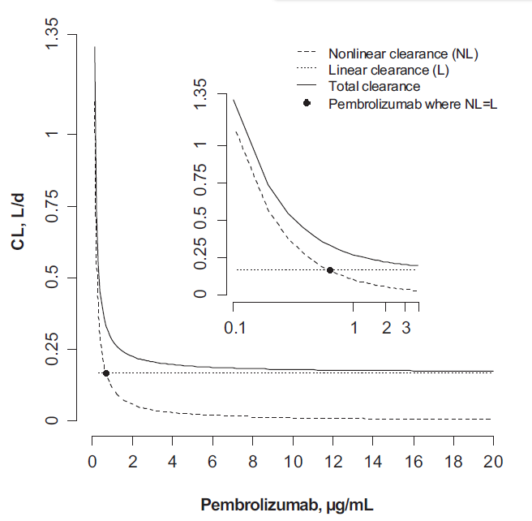
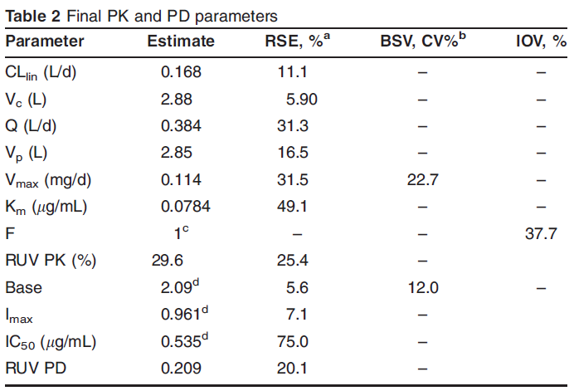
Case Study 1—Cont’d
0.68 ug/mL (0.3 mg/kg)

Slide 13
Case Study 2
Drug B is a monoclonal antibody in the late clinical development for solid tumors with wide therapeutic index
Seven phase I, two phase I/II, six phase II, nine phase III, and one phase IIIb/IV clinical studies had been conducted
A PopPK model was built (next slide) based on 32,835 PK samples from 6,468 patients
The team wants to know whether the dose of Drug B should be adjusted for any intrinsic or extrinsic factors

Slide 14






Case Study 2—Cont’d
Parameter (units) | Estimate | RSE% | BSVª (RSE%)
CL0_{REF} (mL/hour) | 10.8 | 1.50 | 41.2 (5.45)
VC_{REF} (L) | 4.27 | 0.728 | 40.5 (9.8)
Q _{REF} (mL/hour) | 34.9 | 6.91 | -
VP_{REF} (L) | 2.70 | 2.47 | -
CL_{BBWT} | 0.530 | 5.40 | -
CL_{eGFR} | 0.202 | 9.85 | -
CL_{SEX} | −0.181 | 7.35 | -
CL_{PS} | 0.181 | 7.18 | -
CL_{RAAA} | 0.0374 | 86.1 | -
CL_{RAAS} | −0.0354 | 47.7 | -
VC_{BBWT} | 0.534 | 4.49 | -
VC_{SEX} | −0.161 | 8.76 | -
Emax_{REF} | −0.240 | 8.75 | 30.2 (12.9)
T ₅₀ (hour) | 2,200 | 5.95 | -
HILL | 2.77 | 9.49 | -
Emax_{PS} | −0.138 | 14.5 | -
RUV (prop) | 0.245 | 1.65
Final model is represented as following:
$${CL}_{i,t}={CL0}_{i}∙\text{exp}\text{(}\frac{{E\text{max}}_{i}∙t^{{CL}_{HILL}}}{{T50}_{i}^{{CL}_{HILL}}+t^{{CL}_{HILL}}}\text{)}$$
$${CL}_{i,SS}={CL0}_{i}∙\text{exp}\text{(}{E\text{max}}_{i}\text{)}$$
$${CL0}_{i}={CL0}_{REF}∙{(\frac{{BBWT}_{i}}{{BBWT}_{REF}})}^{{CL}_{BBWT}}∙{(\frac{{eGFR}_{i}}{{eGFR}_{REF}})}^{{CL}_{eGFR}}∙e^{{CL}_{SEX}}∙e^{{CL}_{PS}}∙e^{{CL}_{RAAA}}{∙e}^{{CL}_{RAAS}}∙e^{η{CL}_{i}}$$
${E\text{max}}_{i}={E\text{max}}_{{REF}_{i}}+{E\text{max}}_{PS}$+ ${ηE\text{max}}_{i}$
$${VC}_{i}={VC}_{REF}∙{(\frac{{BBWT}_{i}}{{BBWT}_{REF}})}^{{VC}_{BBWT}}∙e^{{VC}_{SEX}}∙e^{η{VC}_{i}}$$
$${VP}_{i}={VP}_{REF}∙{(\frac{{BBWT}_{i}}{{BBWT}_{REF}})}^{{VC}_{BBWT}}∙e^{η{VC}_{i}}$$
$$Q_{i}=Q_{REF}∙{(\frac{{BBWT}_{i}}{{BBWT}_{REF}})}^{{CL}_{BBWT}}∙e^{η{CL}_{i}}$$
Abbreviation: BBWT, baseline bodyweight; CL, clearance; CL0, clearance at time 0; eGFR, estimated glomerular filtration rate; Emax, the maximal change in clearance; HILL, sigmoidicity of the relationship of clearance with time; PS, performance status; Q, intercompartmental clearance; RAAA, African American race; RAAS, Asian race; REF, reference; T 50, time at which the change in CLt,i is 50% of Emax; VC, central volume of distribution; VP, peripheral volume of distribution
ªBSV was calculated as sqrt(exp(variance)-1)

Slide 15
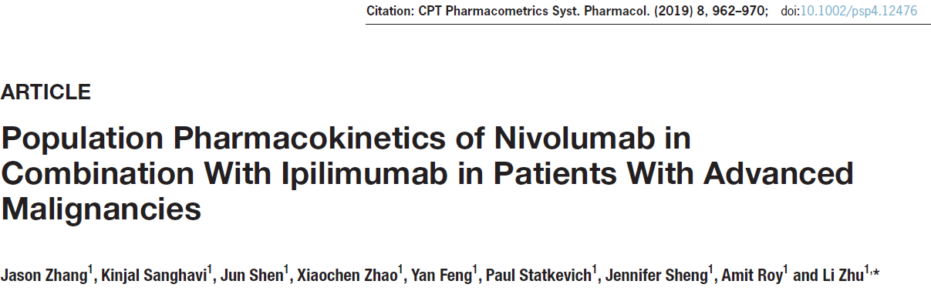
Case Study 2—Cont’d

Slide 16
Case Study 2—Cont’d
Category | Context of use
Question of interest | Does Drug B dose need to be adjusted for intrinsic or extrinsic factors?
Context of use | Utilize a forest plot to assess the impact of covariate effects on key PK parameters
Model risk | Low
Model influence | Low Multiple studies in populations with different conditions, such as different gender, ethnicity, comorbidities, etc. had been conducted
Decision consequence | Median The likelihood of overdose leading to adverse effect is low due to Drug B exhibits good safety profile
Validation plan | Dedicate studies, such as organ impairment or ethnicity bridging study may be conducted to validate the impact of intrinsic or extrinsic factors on PK.
Zhang, et al. Population Pharmacokinetics of Nivolumab in Combination With Ipilimumab in Patients With Advanced Malignancies. CPT Pharmacometrics Syst Pharmacol. 2019; 8, 962-970

Slide 17
Case Study 2—Cont’d
Assessments of the impact of covariate effects were generated via forest plots where the percentage change in PK parameters or exposures of interest (e.g., AUC and Cmax) for a reference dose relative to a reference covariate group was plotted.
The forest plots were generated with simulations informed by parameter sets and dataset covariates. A total of 1000 sets of parameters were sampled from distributions based on parameter estimates and the associated variance-covariance matrix of the final model.
The influence of each covariate was compared against a reference individual PK parameter.
Uncertainty was computed as a 95% CI for each exposure metric.
Notes:
The use of forest plots in drug labeling to summarize important information on the impact of various intrinsic and extrinsic factors on the PK of drugs has been advocated by regulatory agencies. It represents a concise and easy way to present and interpret the most important factors that affect the PK of a drug.

Slide 18
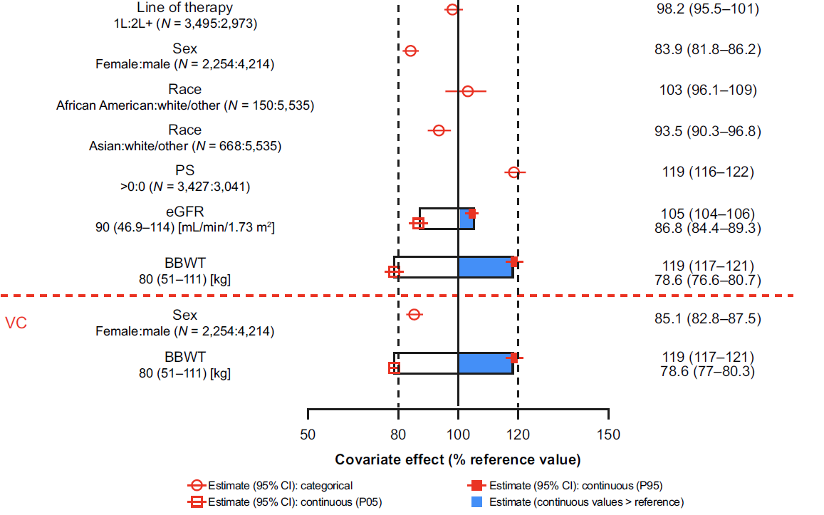
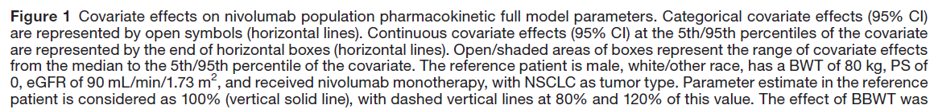
Case Study 2—Cont’d
CL

Slide 19
Model-Informed Drug Development Case Studies
ECP 8506 Clinical Trial Simulation
Dec 13, 2024
Ya-Feng (Jay) Wen, PharmD, PhD
wenxx164@umn.edu | jay.wen3@gilead.com
Clinical Pharmacologist, Gilead Sciences
Adjunct of Assistant Professor, ECP, UMN

